Slide 1


HR Analytics Dashboard
Amir Mohamed

Slide 2

About the data
This dataset contains detailed employee information from a corporate HR system. It includes 1,470 records with 44 features capturing demographic, work, and performance-related attributes. The data is designed to support workforce analytics, including attrition analysis, department-level KPIs, and income trends.
Key fields include:
Demographics: Age, Gender, Marital Status, Education Field
Job Info: Department, Job Role, Years at Company, Performance Rating
Financials: Monthly Income, Stock Option Level, Salary Hike
Engagement Metrics: Job Satisfaction, Work-Life Balance, Training Frequency
Attrition Indicators: Whether the employee has left, and related attrition labels
This structured dataset enables the development of insightful dashboards focusing on:
Average Age and Income
Attrition trends by department, age group, and job role
Gender distribution and educational background
KPI cards and slicers for interactive exploration

Slide 3



What questions do we have ?
What is our total number of employees ?
How Average income differs considering some other aspects ?
How does work life balance affect the income ?

Slide 4
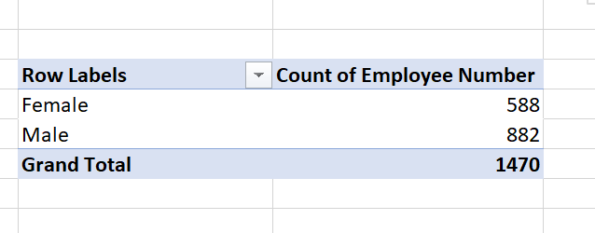
How many Employees do we have ?
Here’s a pivot table showing the total count of employees and the gender distribution

Slide 5
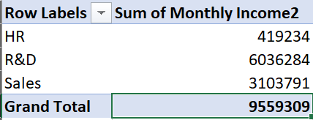
What is the sum of monthly income for all employees ?
Here’s a pivot table showing the Sum of monthly income as a whole, distributed by department.

Slide 6
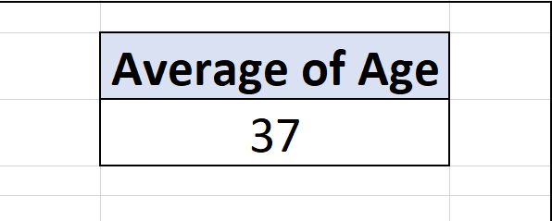
What is the average age of the employees ?
Here’s a pivot table showing the Average age of all employees

Slide 7
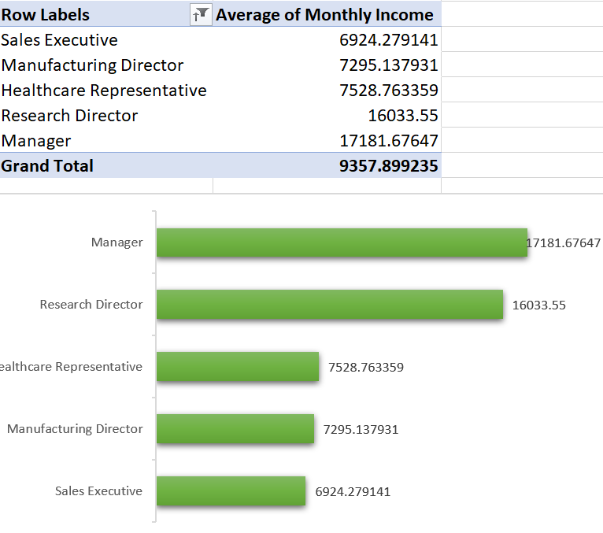
What is the average monthly income for each job role ?
Here’s a pivot table and bar chart showing the Average monthly income for each job role.

Slide 8
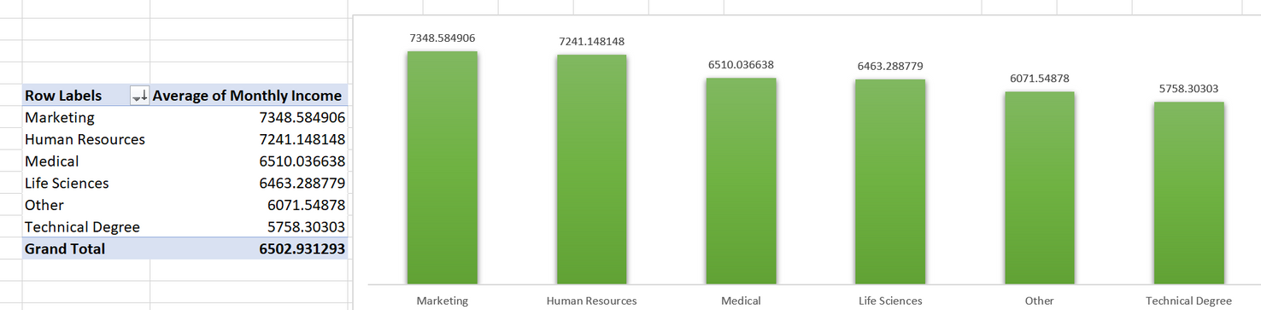
What is the average monthly income for each education field ?
Here’s a pivot table and bar chart showing the Average monthly income for each education field.

Slide 9
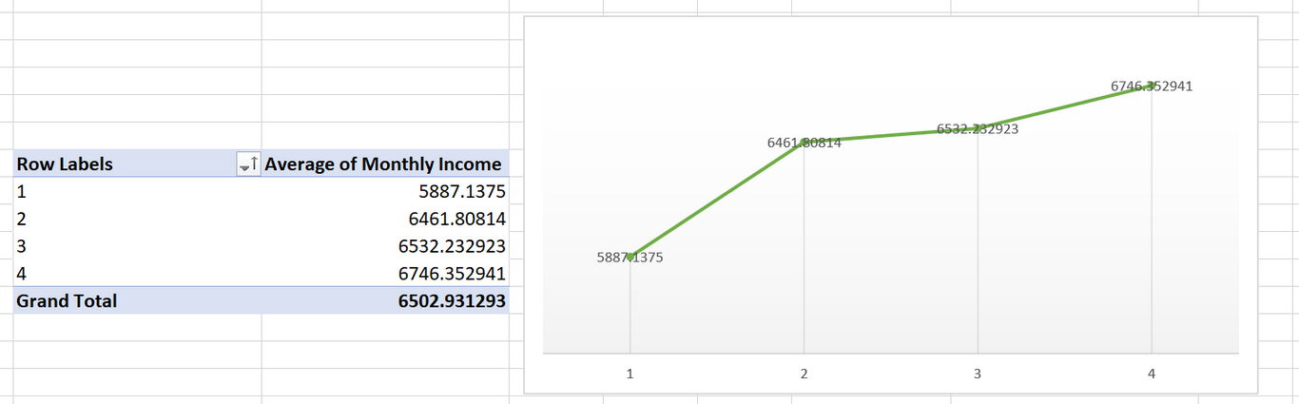
What is the average monthly income for each level of work life balance ?
Here’s a pivot table and bar chart showing the Average monthly income for each level of work life balance.

Slide 10
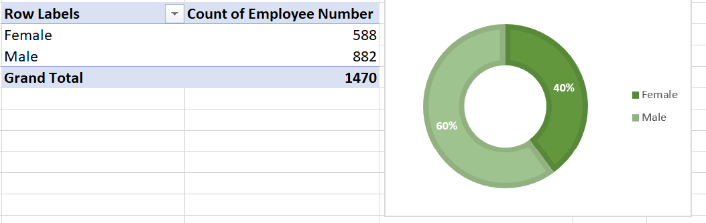
What is the Distribution of employees based on their gender ?
Here’s a pivot table and bar chart showing the Distribution of employees based on their gender

Slide 11
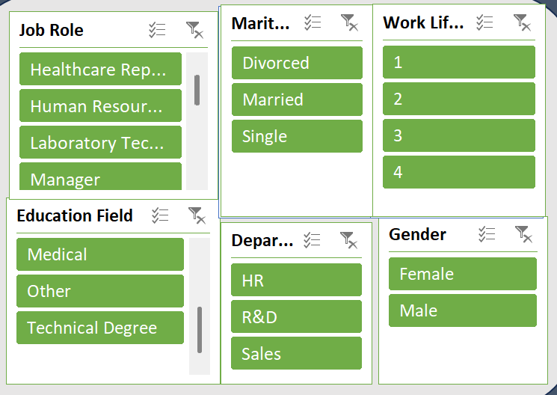
How to view a certain segment of the data ?
Here’s a Slicer panel to show some specific insights based on certain critiria.

Slide 12
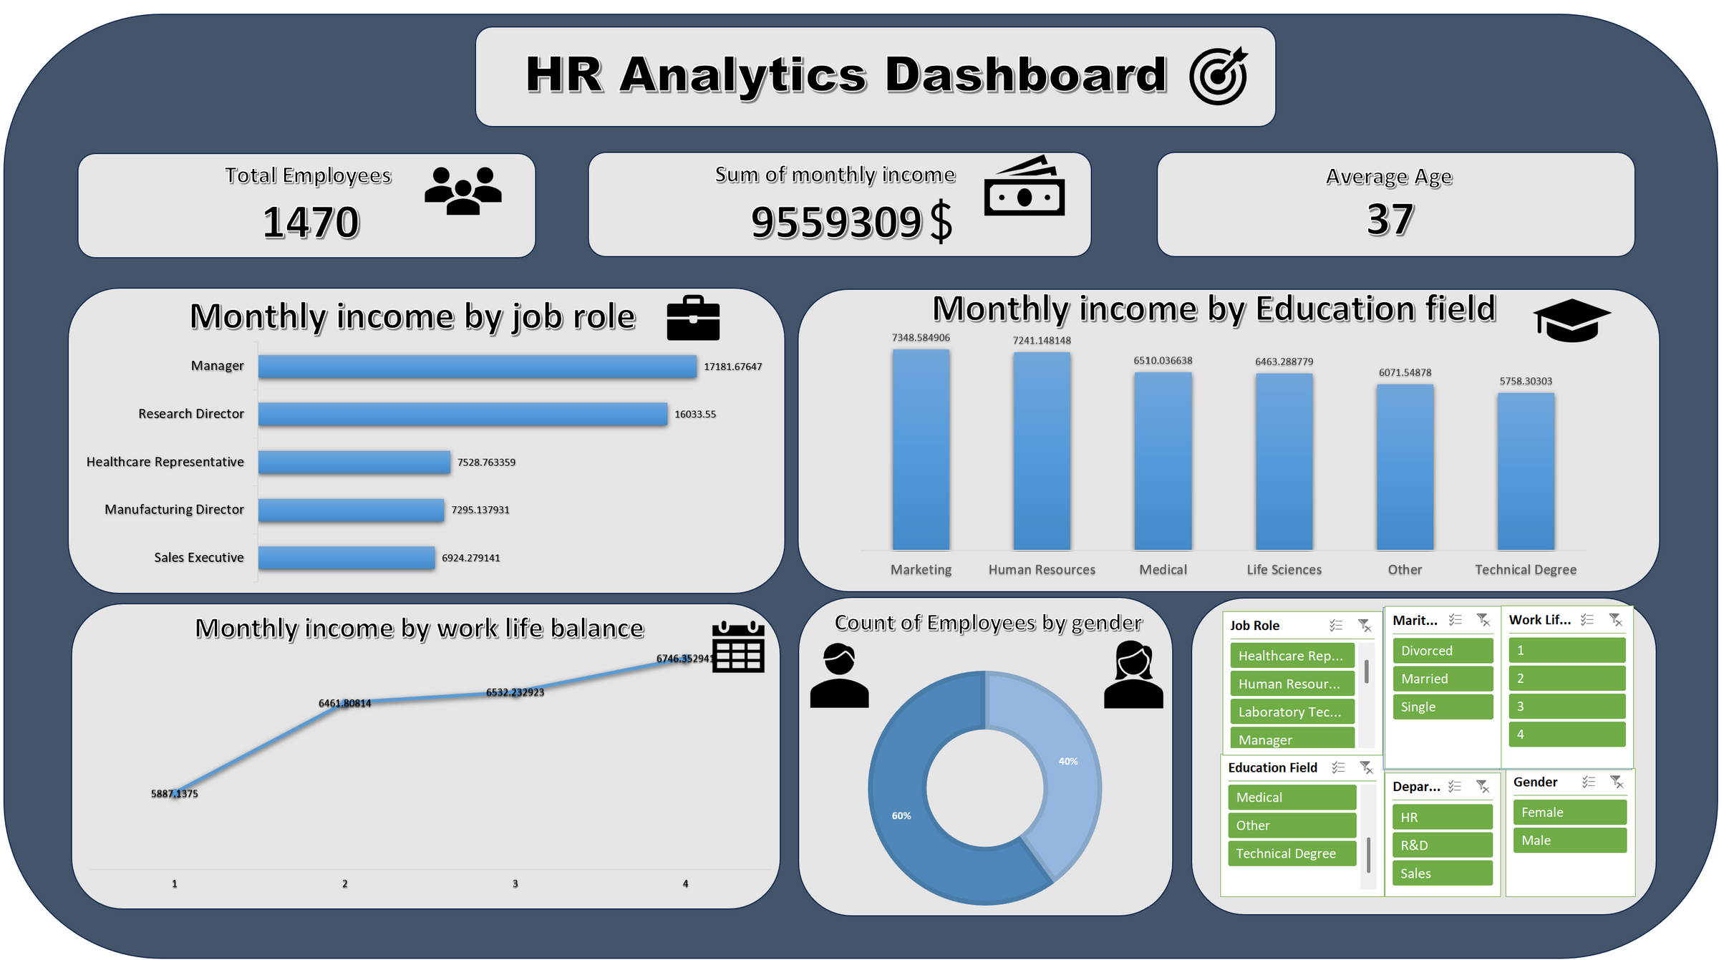

Slide 13



